Slide 1


Computational Thinking II
PSUEDOCODE
Tolu Adeola, Maloney Tutu, Earl Pough, Ralph Reyes

Slide 2

TABLE OF CONTENTS
UML Diagrams
Simulation Details
(S) Pseudocode
(I) Pseudocode
(IZ) Pseudocode
Challenges

Slide 3
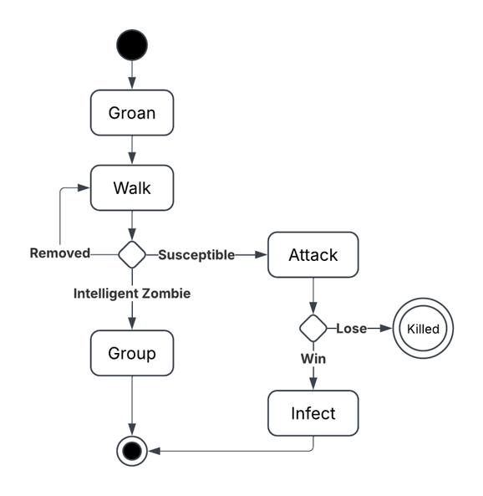
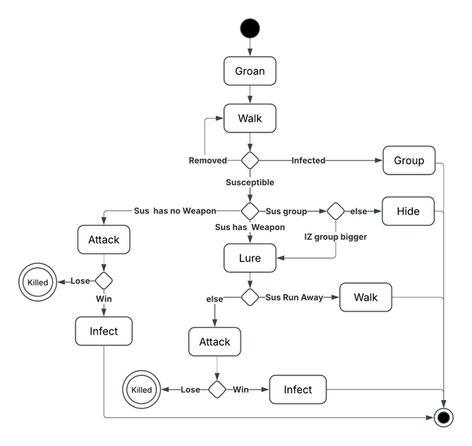
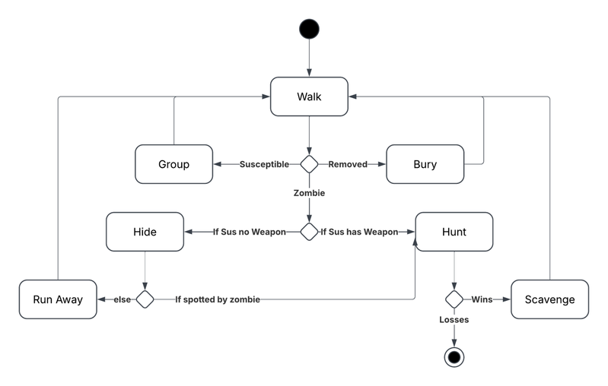
UML DIAGRAMS
S
I
IZ

Slide 4
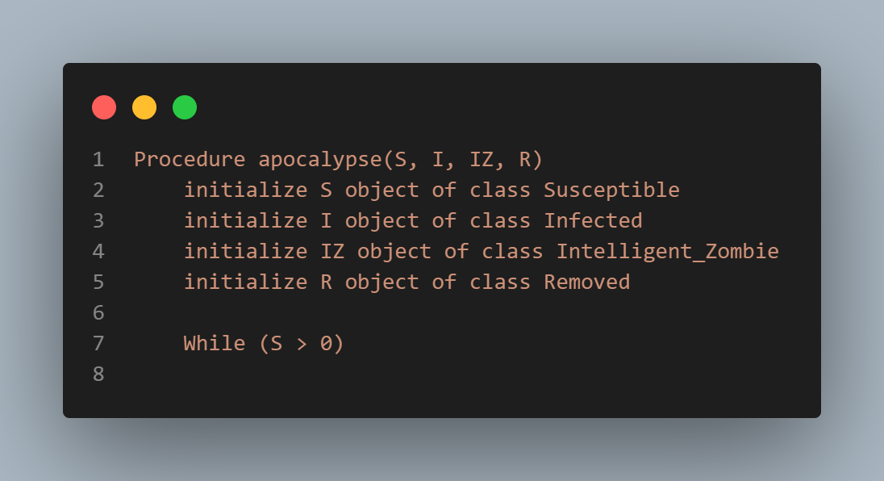
OVERVIEW
SETUP FOR SIMULATION

Slide 5
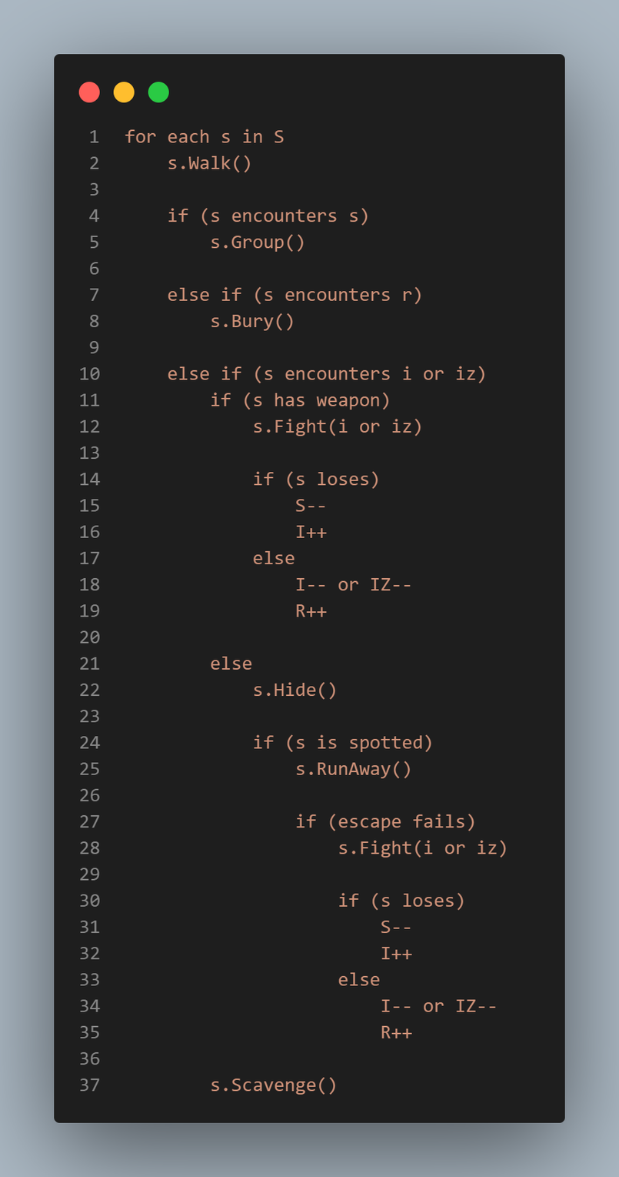
SUSCEPTIBLE
PSEUDOCODE

Slide 6
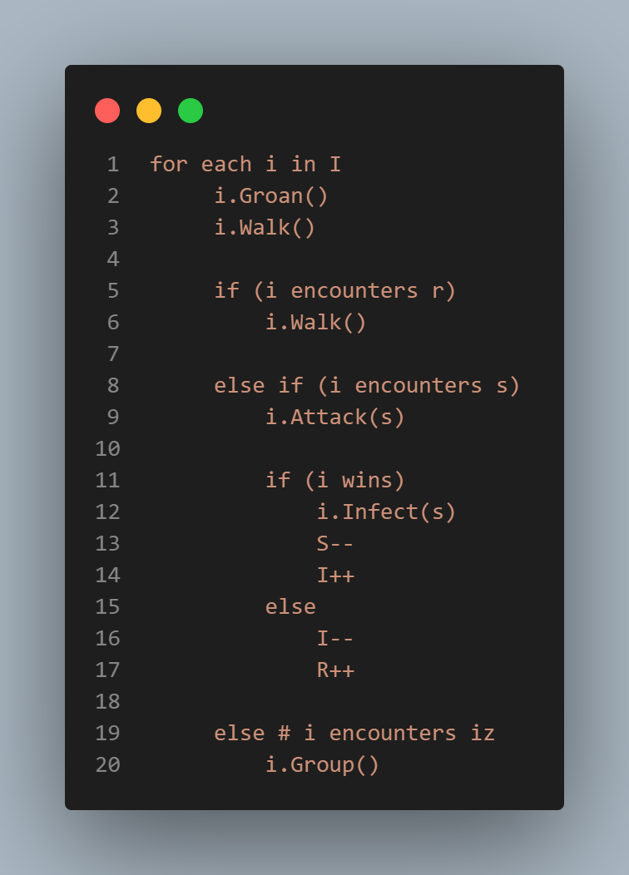
INFECTED PSEUDOCODE

Slide 7
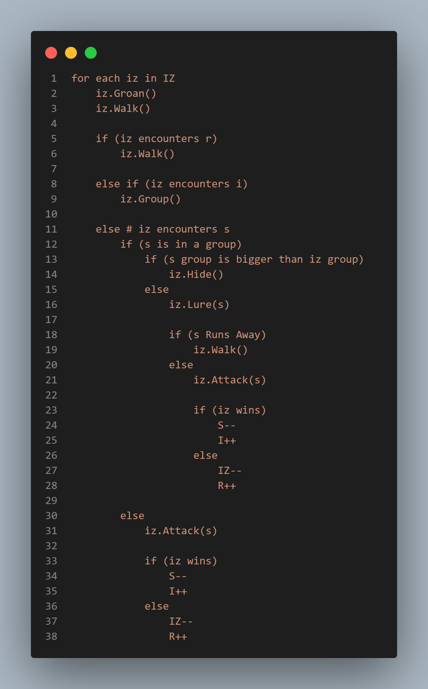
INTELLIGENT ZOMBIE PSEUDOCODE

Slide 8
CHALLENGES
Optimization
UML Diagrams
Pseudocode
Probabilistic or Deterministic
Simulation
Procedure or Function

Slide 9
THANK YOU

